Slide 1
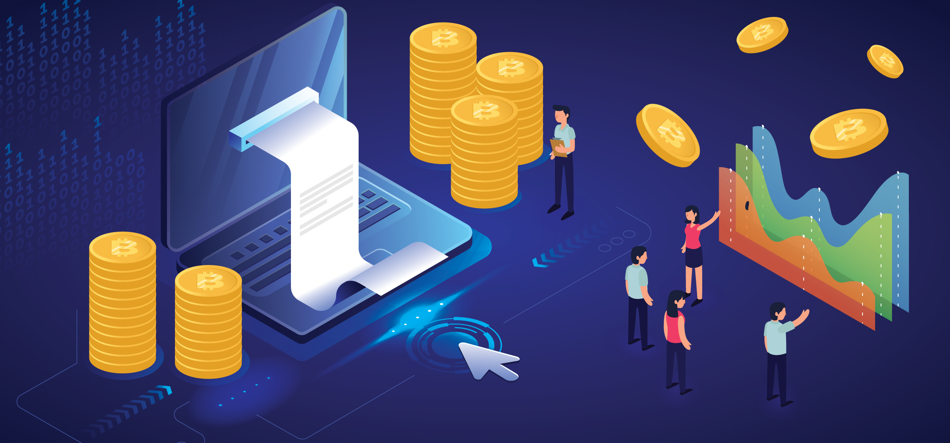
Arb-bot Uber of Intelligent investing
Team #2 - Project 1
Gurpreet Sodhi, Shahan Ahmed, Nicole Mann, Etan Winograd, Peter Leiberman

Slide 2
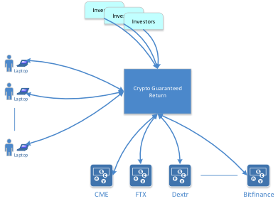
Just bring your credit!
Matching the lenders and investors using smart logic.
Fully automated market scanning to lock the profits.

Slide 3

Technology Breakdown
Python –API Calls, create graphs, calculations, and connects to our SQL database
MYSQL Server – Database engine
HTML – Markup language used for graphical Interface
JavaScript – Processes the user interactions.
PHP – Server side communication

Slide 4

Data Preparation
FTX data collection via API
Top 5 coins: BTC, ETH, SOL, XRP, MATIC
Combine all data into a single data frame including data cleanup
Calculates arbitrage spreads, presents arbitrage spread as % of spot price, and 30-Day Simple Moving Average

Slide 5
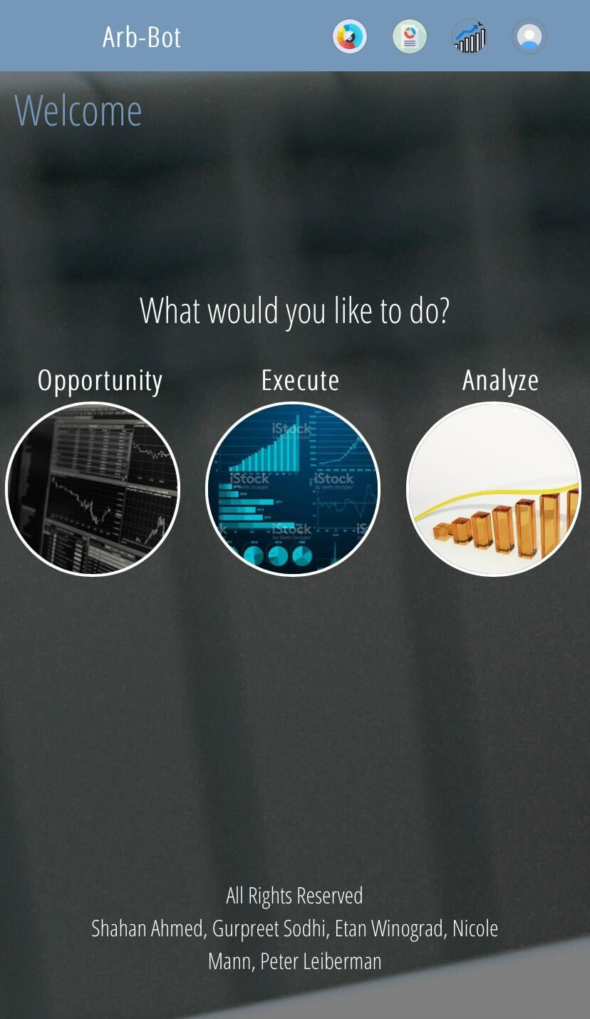
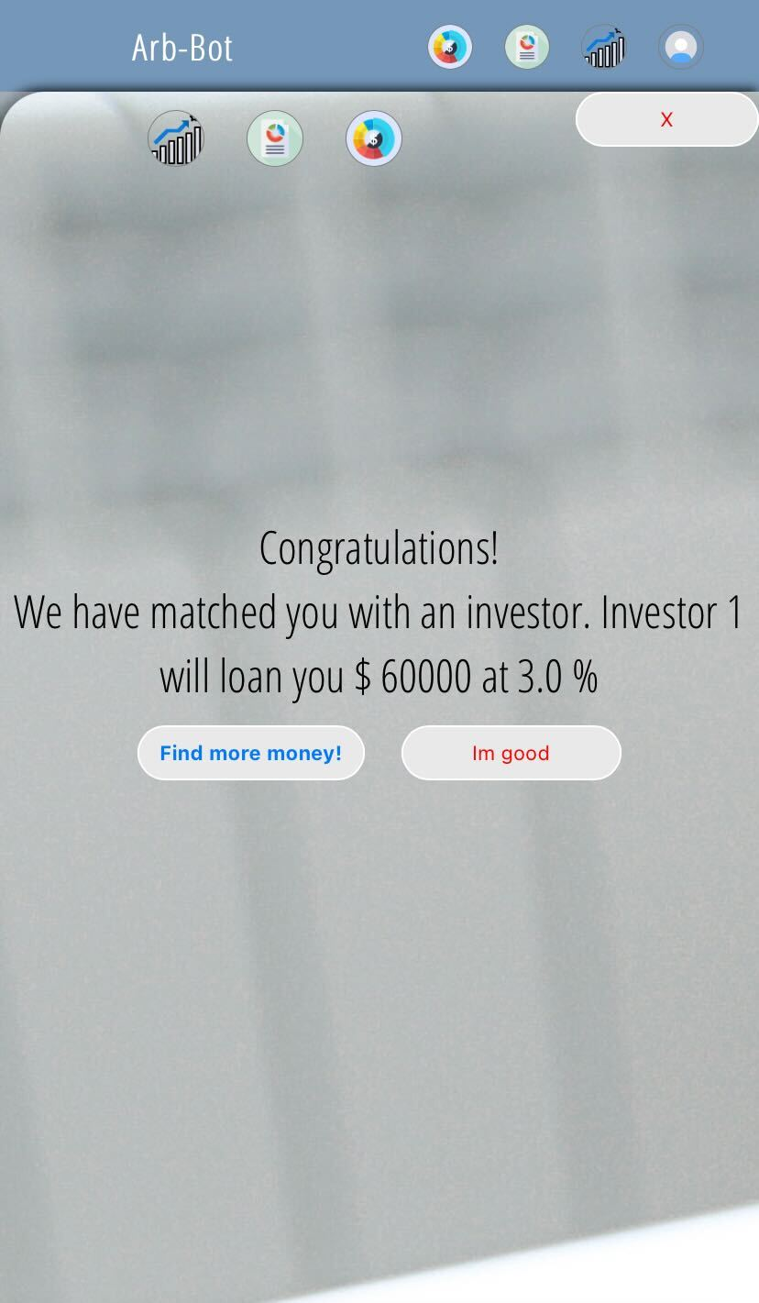
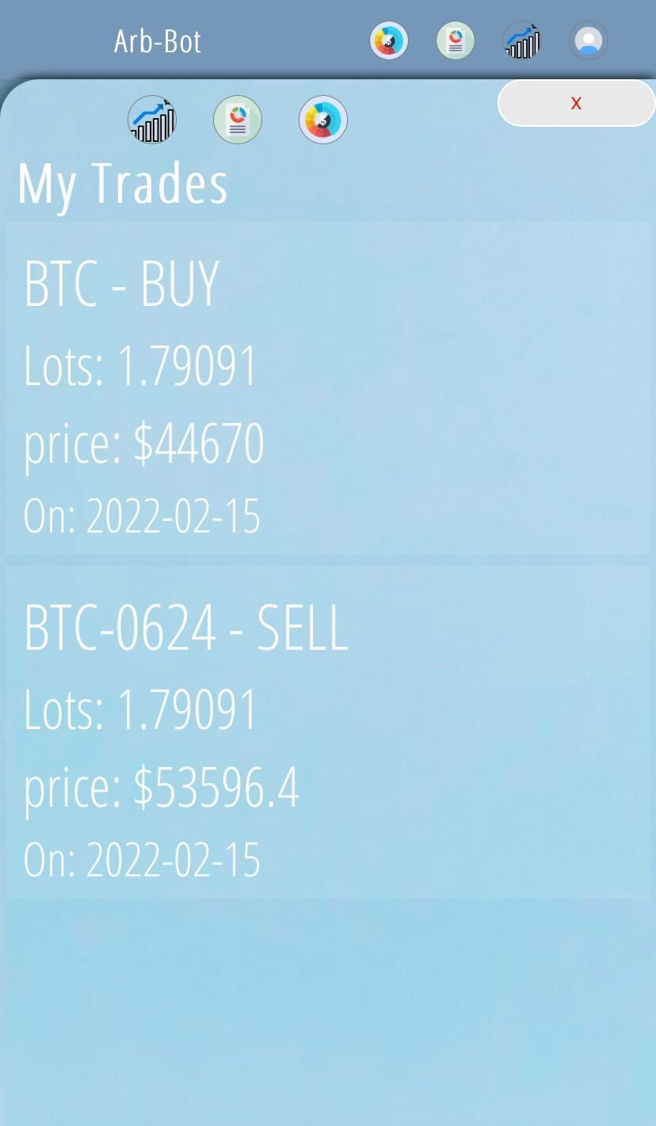
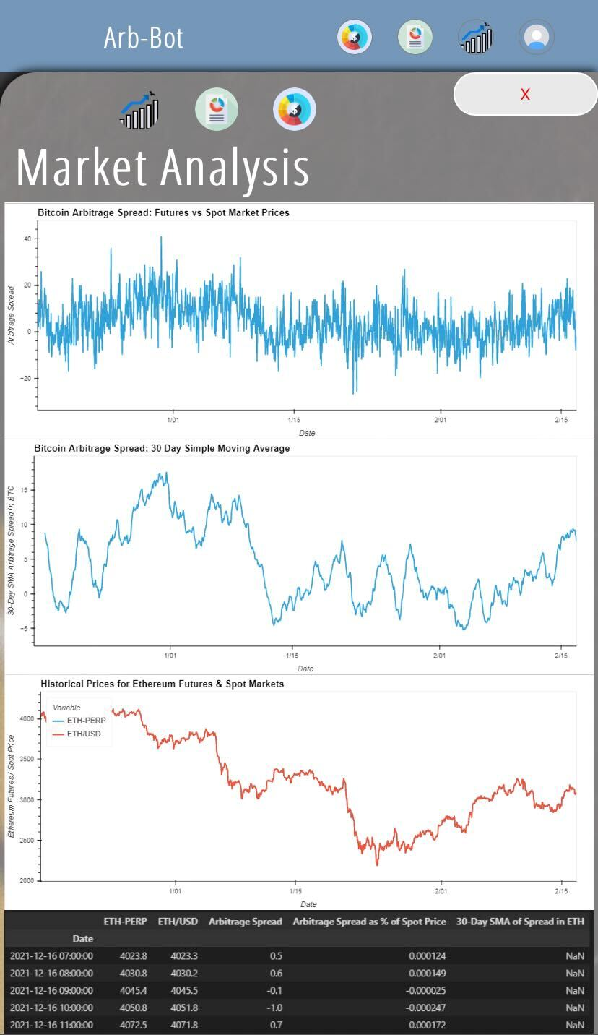
Demonstration
Bring your credit and get funded instantaneous
Let Arb-bot find you profit making trades
Market analytics

Slide 6

Scale Up Are you ready to fund?
Expand connectivity to multiple exchanges
Streamline the loan approval process
Error handling and improve security

Slide 7
Conclusions Win-Win Eco system
With Arb-bot:
Successfully matched the investors and lenders while providing the best return to our investors
Found Arb opportunities in real time to lock in profits for our investors

